Slide 1



Forecasting

Slide 2
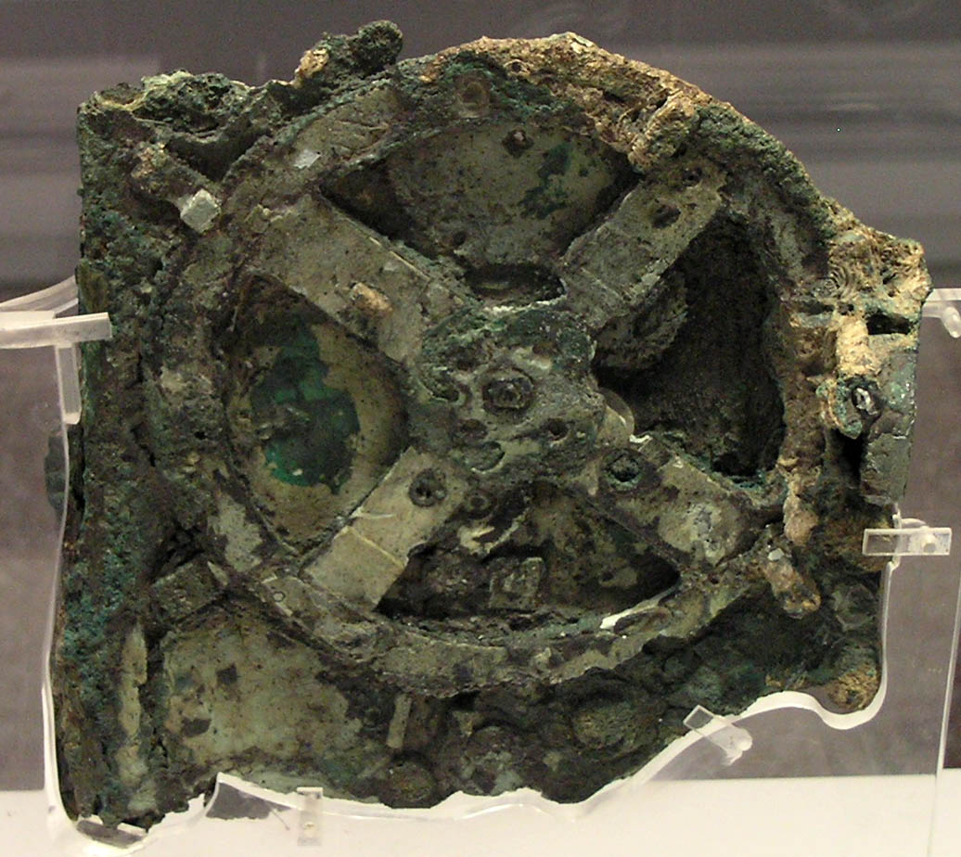
A Brief History of forecasting
People have been working around time series data from a very ancient time, back then using analog devices to calculate solar and lunar eclipses.
The Antikythera mechanism (Fragment A – front and rear), This artefact was among wreckage retrieved from a shipwreck off the coast of the Greek island Antikythera in 1901.
source: No machine-readable author provided. Marsyas

Slide 3
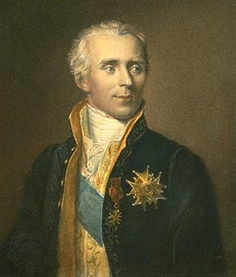
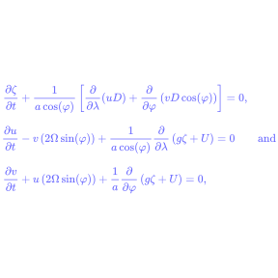
A Brief History of forecasting
In 1700 Pierre-Simon Laplace derived a few sets a differential equations for solving the tidal waves , those differential equation were based on astronomical frequencies that of the sun , the moon and the eccentricity of lunar orbit. if someone could combine these frequencies then tides could finally be predicted.
source : https://en.wikipedia.org/wiki/Theory_of_tides

Slide 4
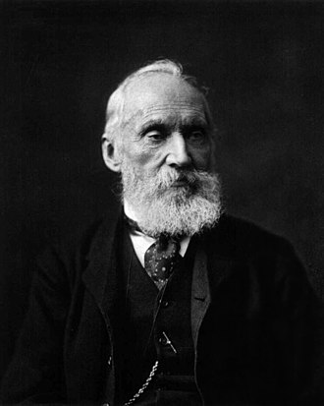
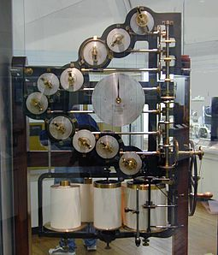
A Brief History of forecasting
In next century William Thomson
took the challenge about how to combine the frequencies and predict the tides, He came up with techniques to decompose the principal component frequencies of a tide and also techniques to combine them for future predictions.
source: https://en.wikipedia.org/wiki/William_Thomson,_1st_Baron_Kelvin

Slide 5
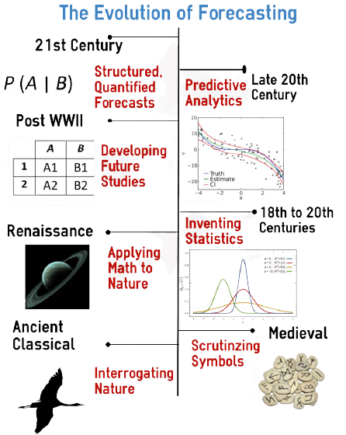
source: https://foresightr.com/2016/05/06/a-brief-history-of-forecasting/

Slide 6
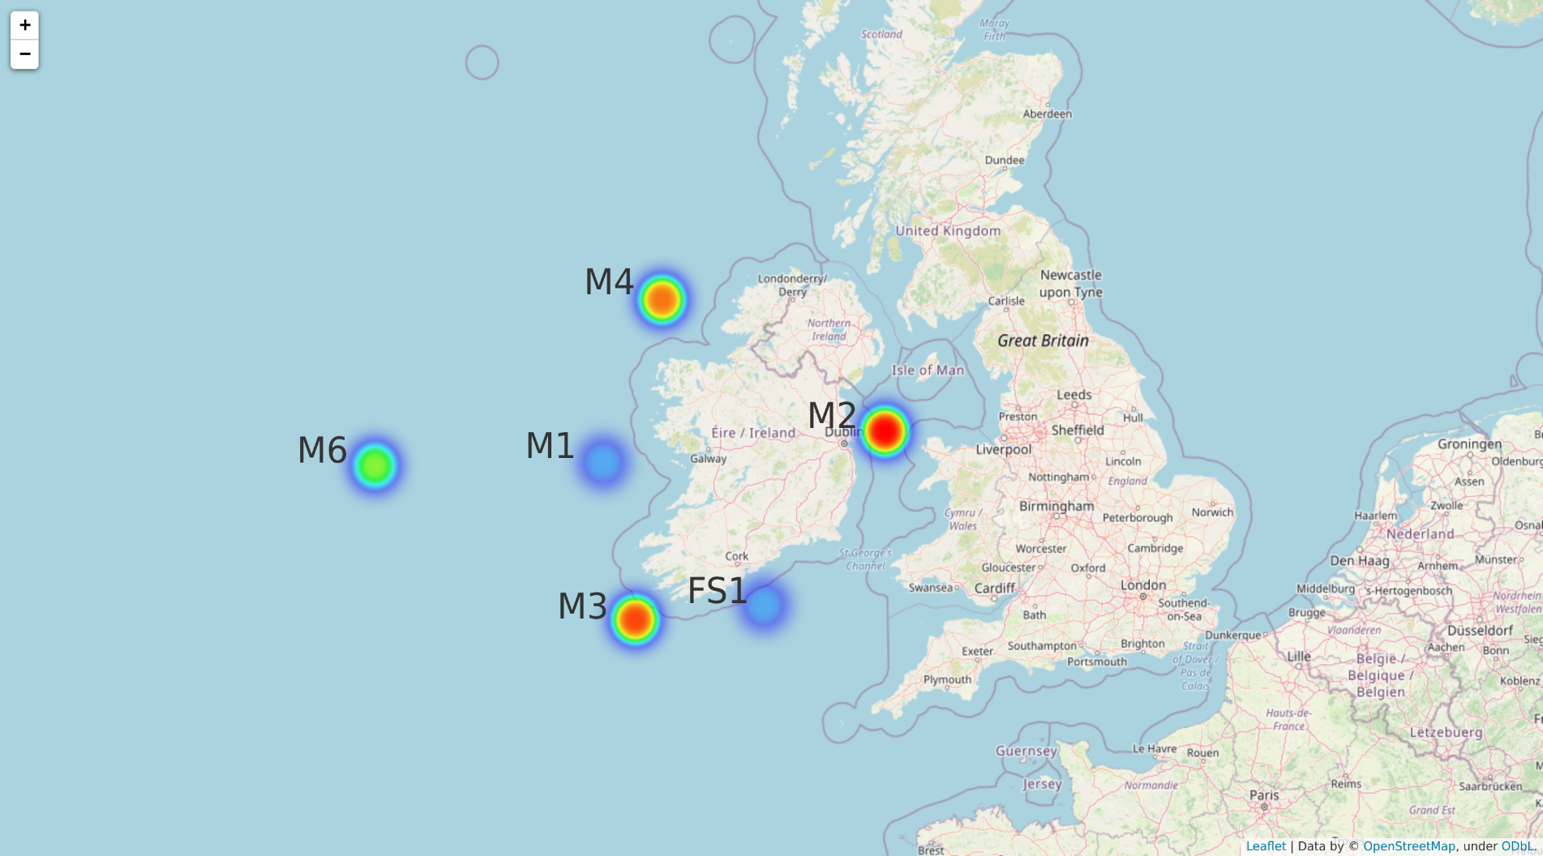
Our Data
Buoy data from various sites near Ireland
Station M1
Station M2
Station M3
Station M4
Station M5
Station M6
Station Belmullet-AMETS
Station FS1

Slide 7
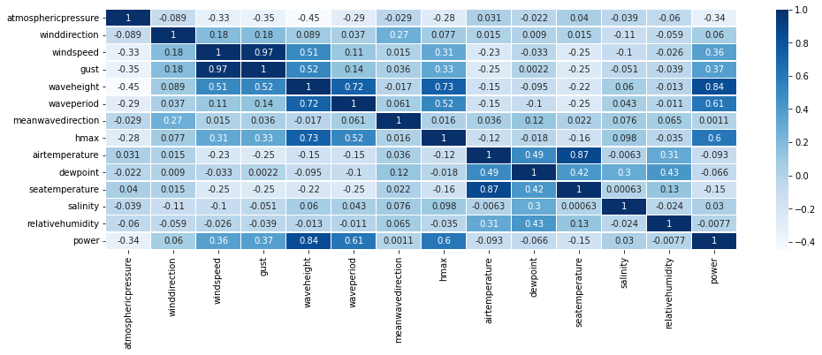
Initial challenges with data
Features in the csv file were not much co-related and exclusively there were not impacting performance for a multivariate model .

Slide 8
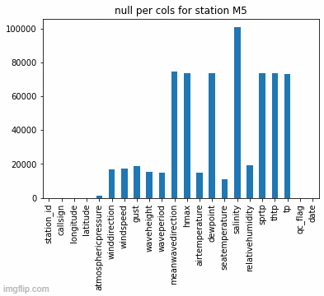
Initial challenges with data
There were a lot of missing data , for some stations data was missing for an entire year , which needed to be imputed , various available imputation methods were explored , the best so far result was produced by pchip method and forecasting missing data using prophet/fable library

Slide 9
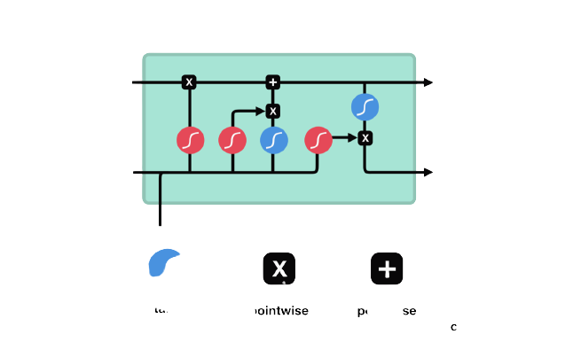
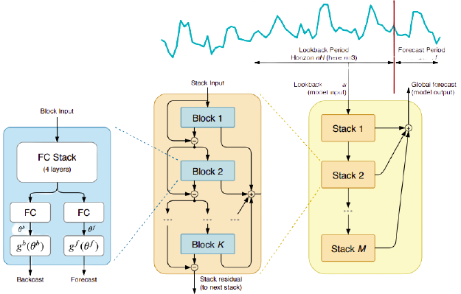
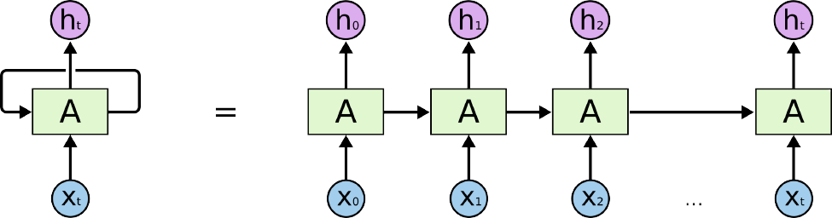
Methods used by us for forecasting
Arima model
Facebook’s prophet library
Deep-neural network
RNN Model
LSTM Model
N-beats deep model

Slide 10
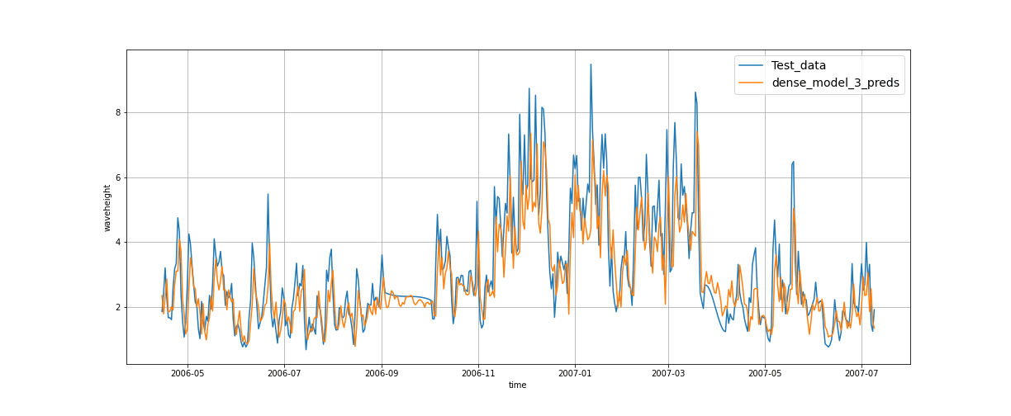
Forecasting for station M1 (wave height)

Slide 11
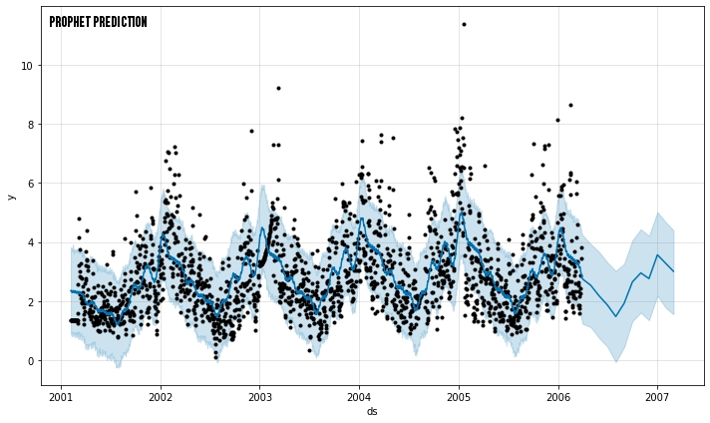
Forecasting for station M1 (wave height) prophet library and error values
MODEL NAME | RMSE
Arima | 1.082407
Naïve model | 1.009678
Dense model 1 | 1.066129
RNN model | 1.014089
LSTM model | 1.002095
NBEATS model | 1.263796
Prophet Library | 1.273494

Slide 12
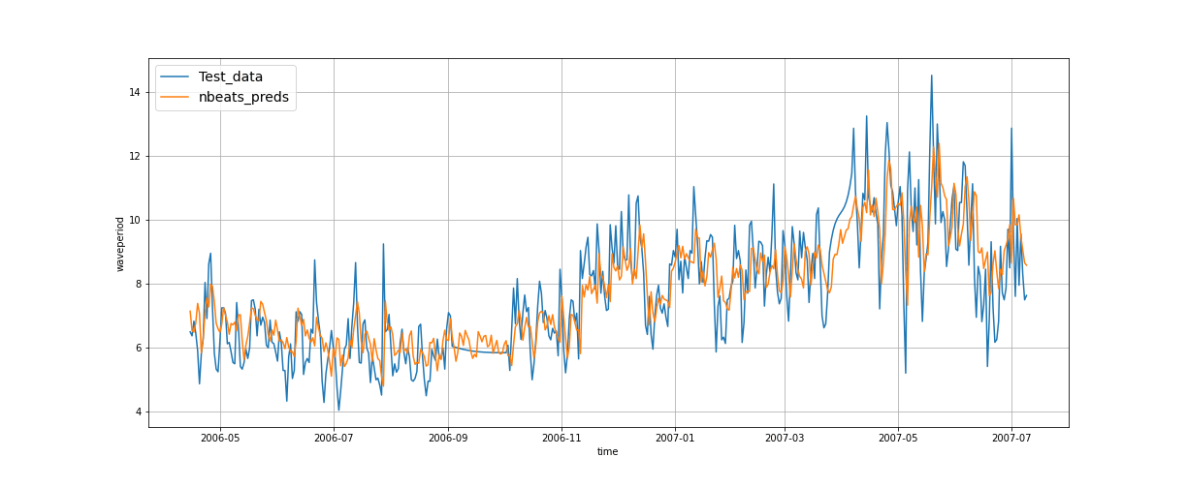
Forecasting for station M1 (wave period)

Slide 13
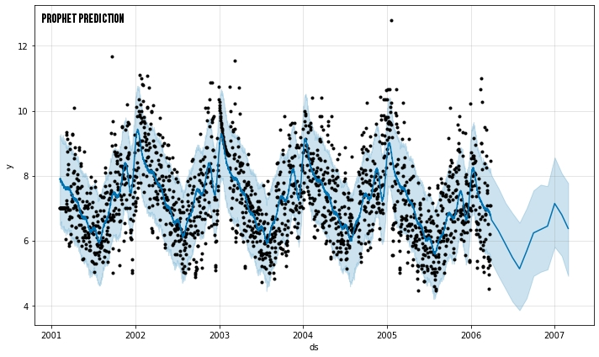
Forecasting for station M1 (wave period) prophet library and error values
MODEL NAME | RMSE
Arima | 1.813871
Naïve model | 1.143823
Dense model 1 | 1.262482
RNN model | 1.072920
LSTM model | 1.096433
NBEATS model | 1.119476
Prophet Library | 1.454331

Slide 14
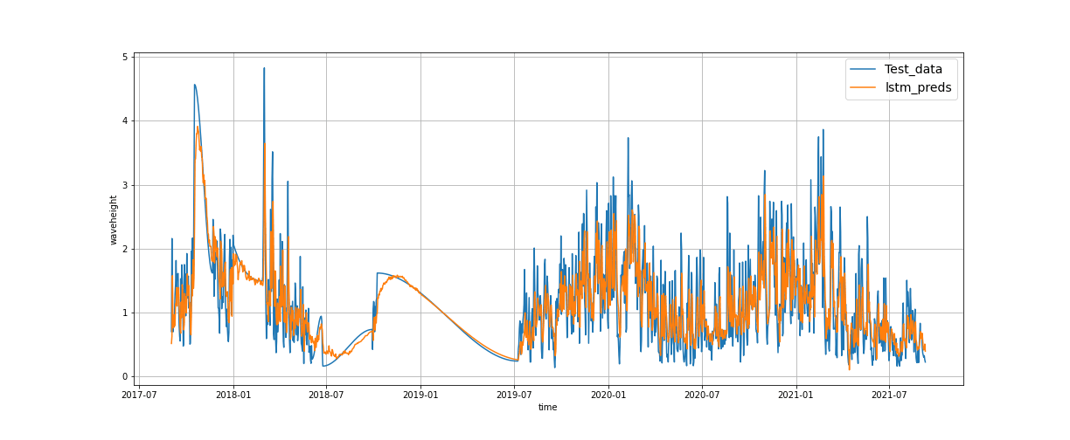
Forecasting for station M2 (wave height)

Slide 15
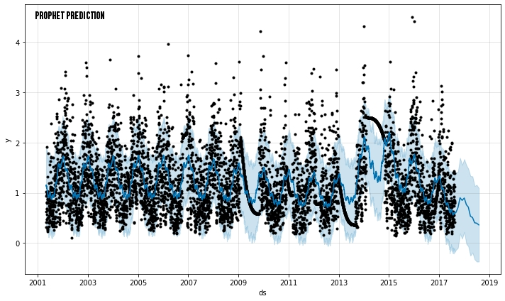
Forecasting for station M2 (wave height) prophet library and error values
MODEL NAME | RMSE
Arima | 0.817976
Naïve model | 0.489979
Dense model 1 | 0.552914
RNN model | 0.462726
LSTM model | 0.455120
NBEATS model | 0.475130
Prophet Library | 0.403872

Slide 16
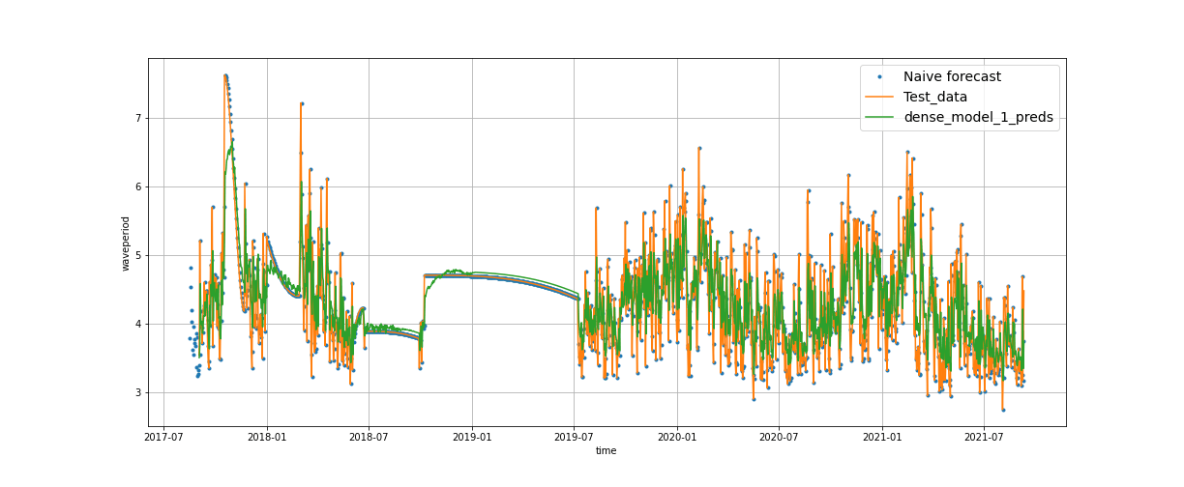
Forecasting for station M2 (wave period)

Slide 17
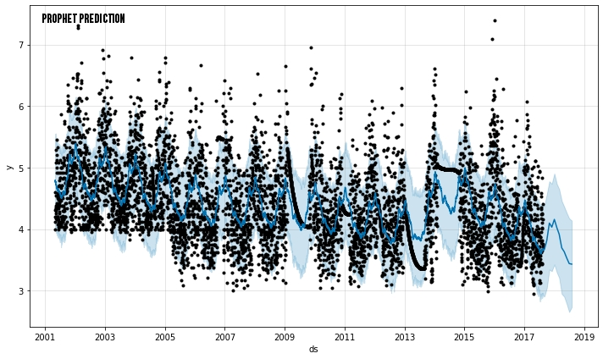
Forecasting for station M2 (wave period) prophet library and error values
MODEL NAME | RMSE
Arima | 0.817976
Naïve model | 0.505858
Dense model 1 | 0.472730
RNN model | 0.453782
LSTM model | 0.468257
NBEATS model | 0.778659
Prophet Library | 0.524527

Slide 18
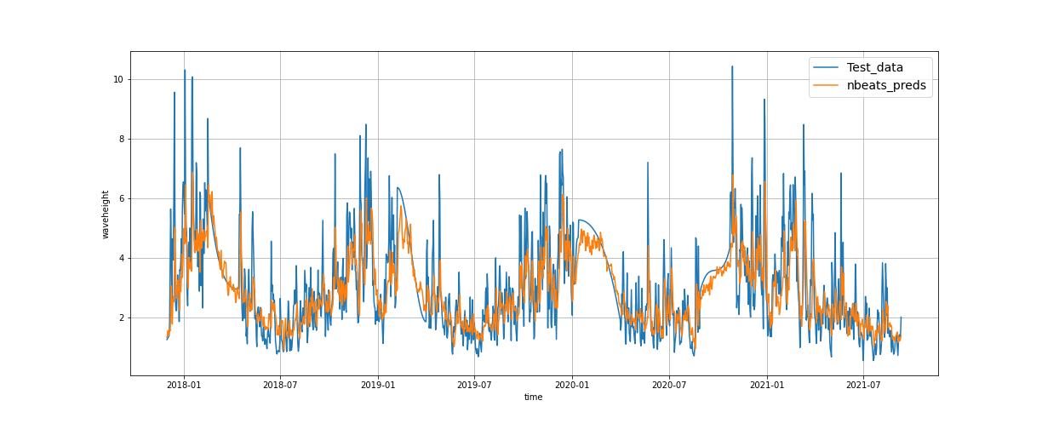
Forecasting for station M3 (wave height)

Slide 19
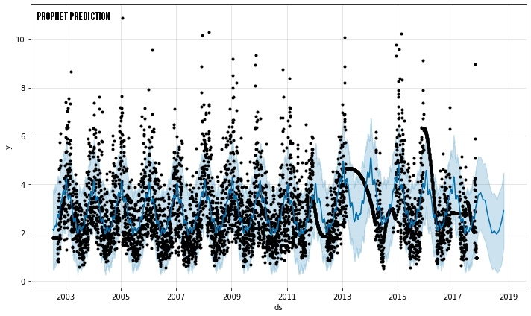
Forecasting for station M2 (wave height) prophet library and error values
MODEL NAME | RMSE
Arima | 1.109799
Naïve model | 0.997922
Dense model 1 | 1.009799
RNN model | 0.943373
LSTM model | 0.965732
NBEATS model | 0.9196005
Prophet Library | 1.52913

Slide 20
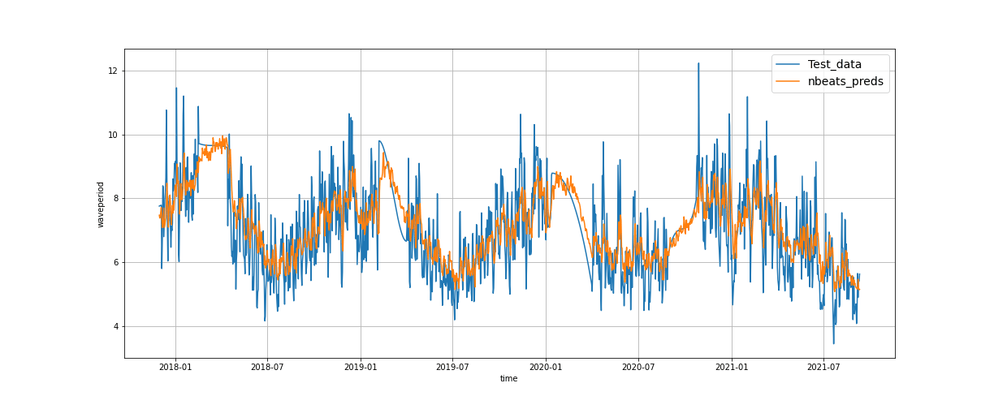
Forecasting for station M3 (wave period)

Slide 21
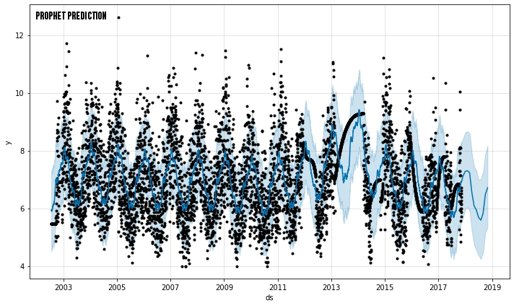
Forecasting for station M2 (wave period) prophet library and error values
MODEL NAME | RMSE
Arima | 0.988361
Naïve model | 0.929953
Dense model 1 | 0.917768
RNN model | 0.859786
LSTM model | 0.965732
NBEATS model | 1.053355
Prophet Library | 0.8243404

Slide 22
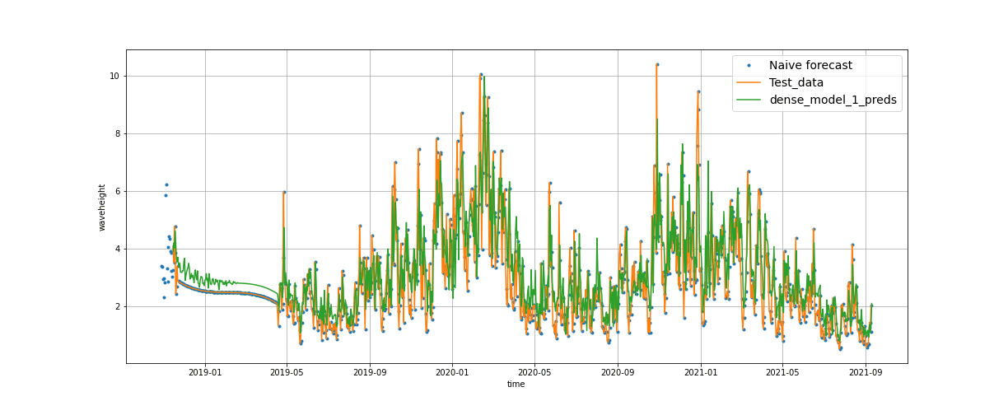
Forecasting for station M4 (wave height)

Slide 23
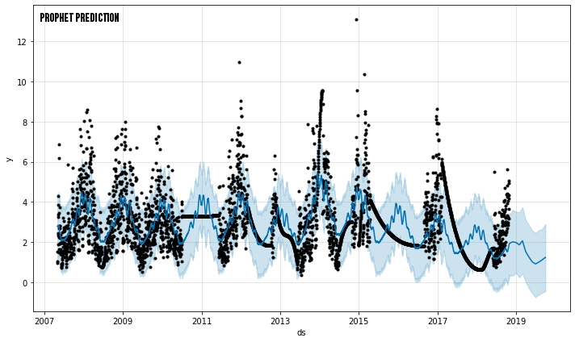
Forecasting for station M4 (wave height) prophet library and error values
MODEL NAME | RMSE
Arima | 1.06891
Naïve model | 0.979691
Dense model 1 | 1.026949
RNN model | 0.927924
LSTM model | 0.939171
NBEATS model | 1.071086
Prophet Library | 1.70128

Slide 24
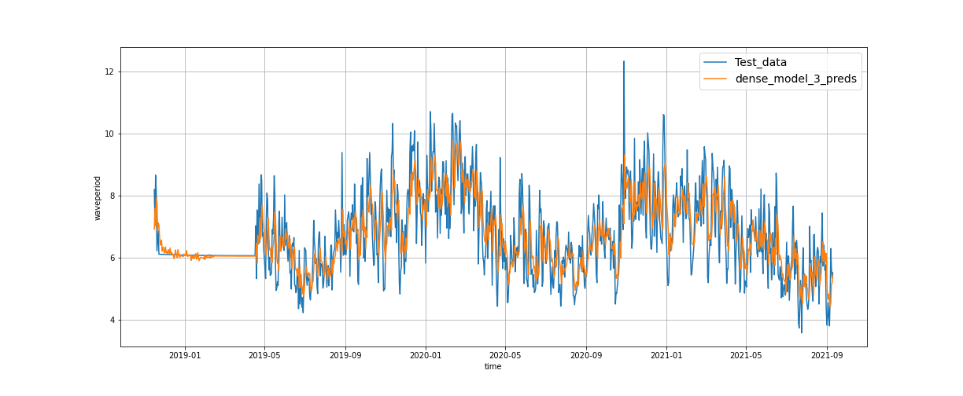
Forecasting for station M4 (wave period)

Slide 25
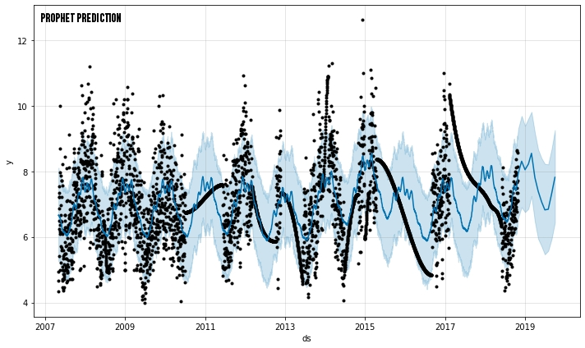
Forecasting for station M4 (wave period) prophet library and error values
MODEL NAME | RMSE
Arima | 1.06891
Naïve model | 0.979691
Dense model 1 | 1.026949
RNN model | 0.927924
LSTM model | 0.939171
NBEATS model | 1.071086
Prophet Library | 1.70128

Slide 26
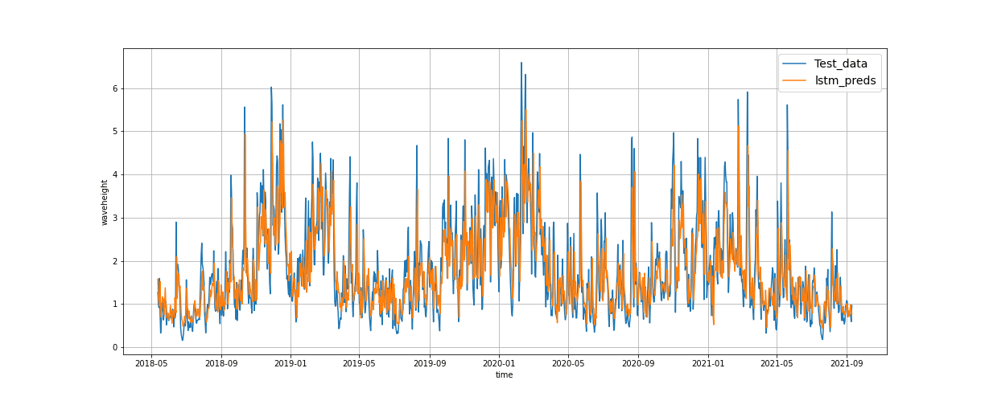
Forecasting for station M5 (wave height)

Slide 27
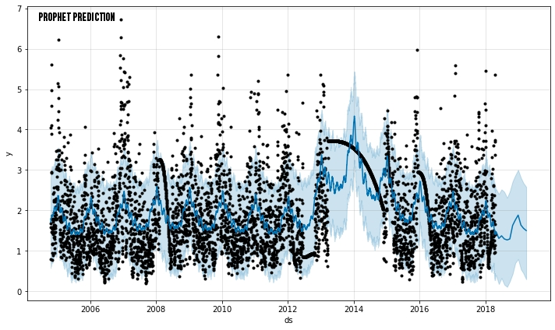
Forecasting for station M5 (wave height) prophet library and error values
MODEL NAME | RMSE
Arima | 0.9173301
Naïve model | 0.76026
Dense model 1 | 0.748688
RNN model | 0.728736
LSTM model | 0.720449
NBEATS model | 0.7893503
Prophet Library | 0.599029

Slide 28
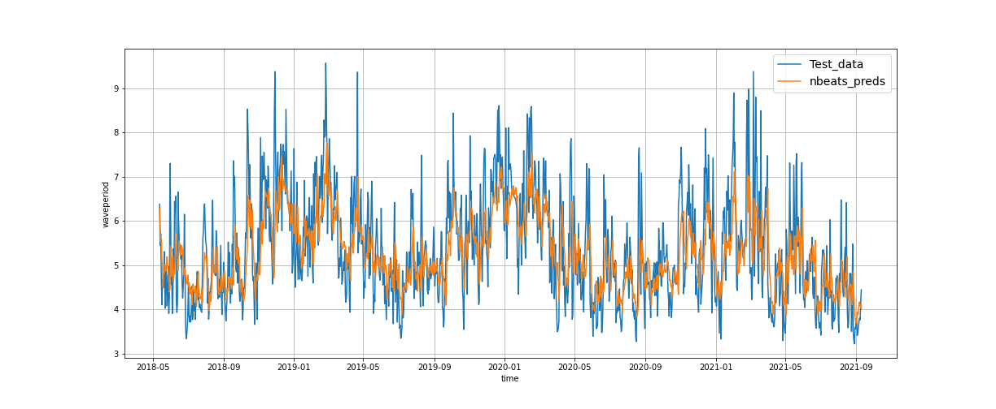
Forecasting for station M5 (wave period)

Slide 29
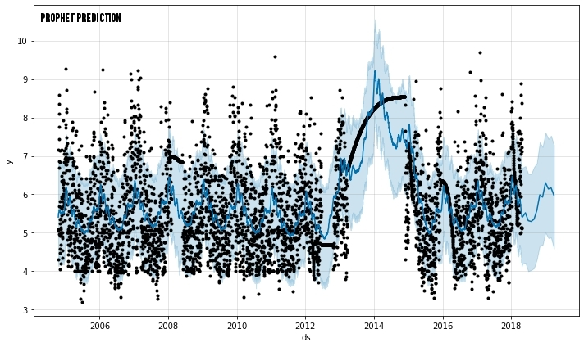
Forecasting for station M5 (wave period) prophet library and error values
MODEL NAME | RMSE
Arima | 1.33137
Naïve model | 0.849924
Dense model 1 | 0.929869
RNN model | 0.813445
LSTM model | 0.806158
NBEATS model | 0.877147
Prophet Library | 0.626792

Slide 30
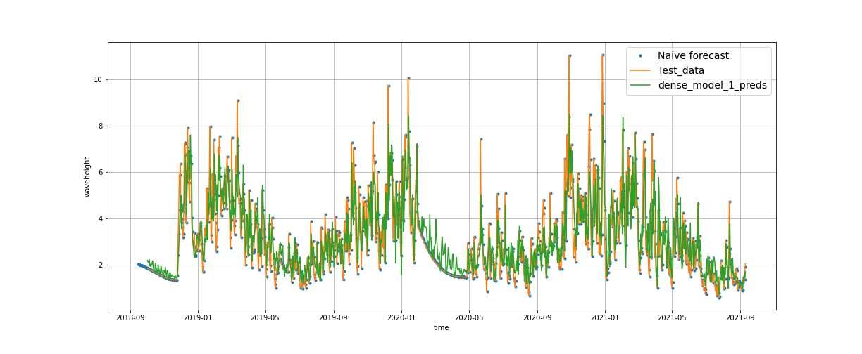
Forecasting for station M6 (wave height)

Slide 31
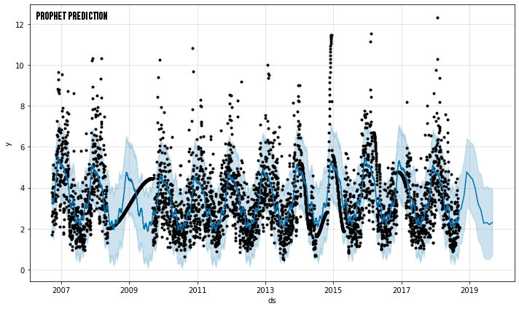
Forecasting for station M6 (wave height) prophet library and error values
MODEL NAME | RMSE
Arima | 1.33137
Naïve model | 1.050413
Dense model 1 | 1.098874
RNN model | 1.017591
LSTM model | 1.038038
NBEATS model | 1.102716
Prophet Library | 1.061197

Slide 32
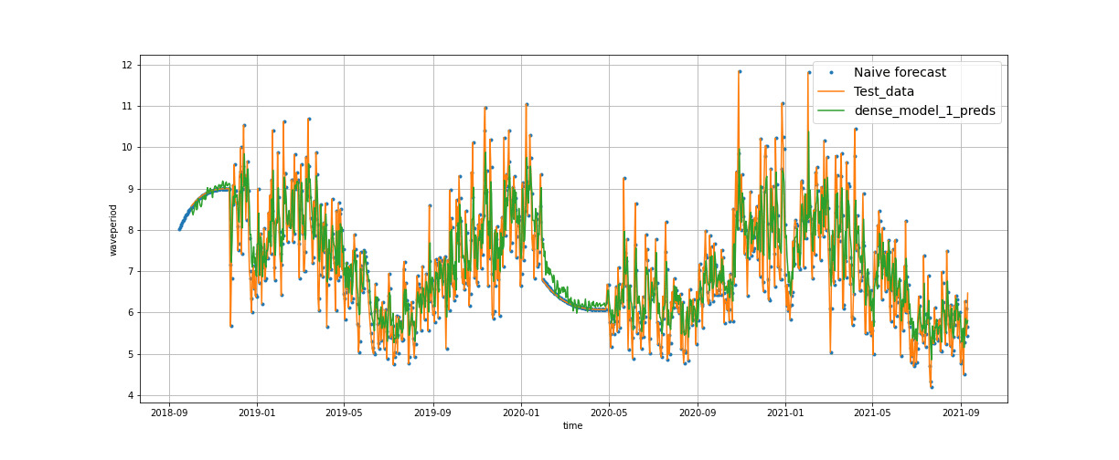
Forecasting for station M6 (wave period)

Slide 33
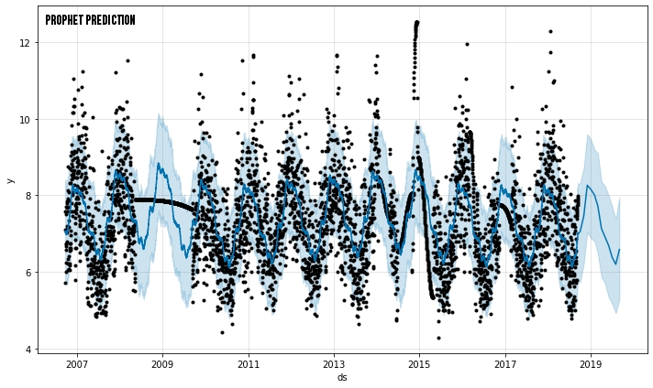
Forecasting for station M6 (wave period) prophet library and error values
MODEL NAME | RMSE
Arima | 1.33137
Naïve model | 0.871653
Dense model 1 | 0.810138
RNN model | 0.804615
LSTM model | 0.814253
NBEATS model | 0.859509
Prophet Library | 1.020589

Slide 34
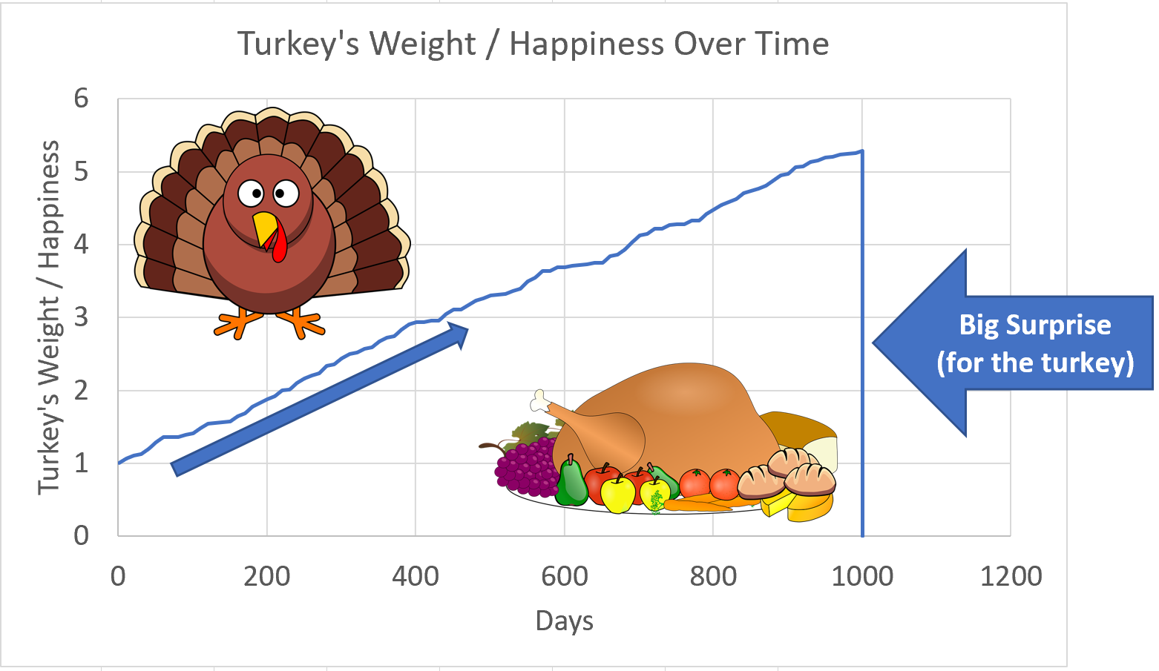
Cautionary tale about forecasting
source: https://crowdwise.org/investing-psychology/four-lessons-turkeys-teach-investing/

